Slide 1
Central African Kingdoms

Slide 2
The Kongo Kingdom
Emerged around the 14th century when several farming villages merged and started conquering others.
The kingdom emerged south of the mouth of the Congo (Zaire) river, north of Malebo Pool [map p.149]
Two rival kingdoms Loango and Tio emerged north of the river, around the same time

Slide 3
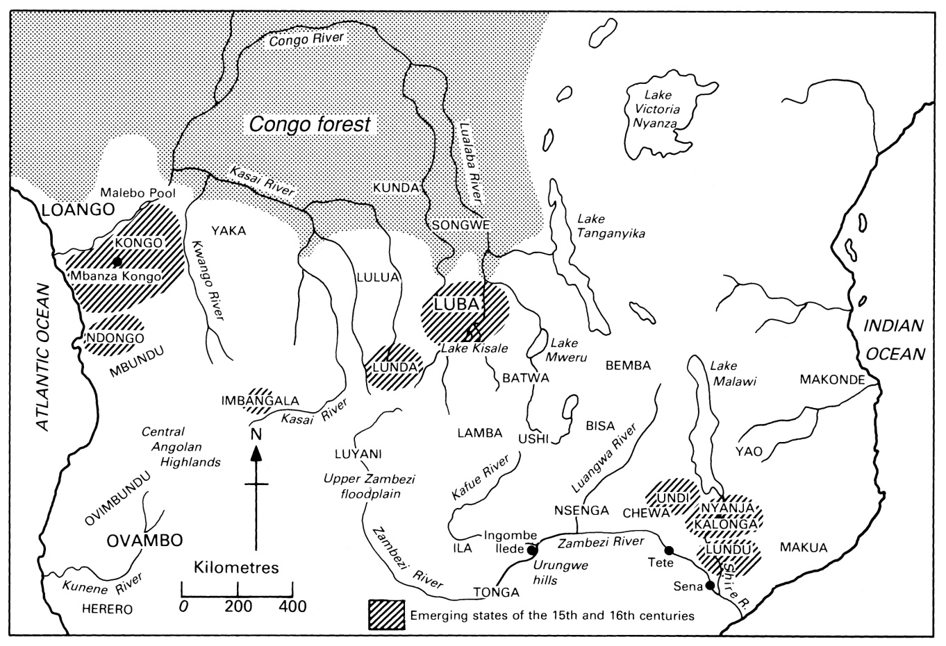
Central African Kingdoms

Slide 4
Kongo
Developed in an area with rich soils, plentiful rains and mineral resources
River and its tributaries ideal for fishing and transportation
Kingdom developed into a highly centralized state – Manikongo the ruler
Mbanza Kongo was the capital of the kingdom
King was supreme religious ruler

Slide 5
Kongo Economy
Highly developed arts and crafts
Skilled metal-workers, potters and weavers
Traded fine cloth woven from fibers of raffia palm
Tribute system provided revenue to rulers
Royal fishery provided shells – used as currency
Agriculture – bananas, millet, maize and cassava later imports
Women were the main cultivators

Slide 6
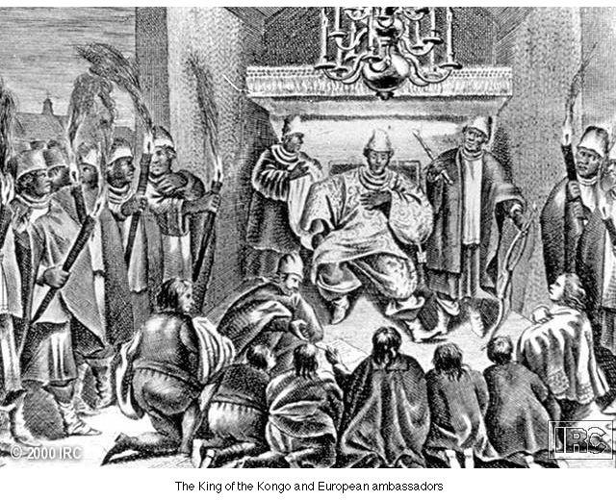
The King of Kongo and European Ambassadors

Slide 7
The Portuguese and Kongo
Arrived in the 1480s
Established settlements on Sao Tome
Relations with Manikongo were cordial
Internal strife – Pro and anti-Portuguese factions
With Portuguese help king prevailed
Baptized and took the name Afonso 1

Slide 8
Motives
King of Kongo wanted teachers and craftsmen to train his people
Firearms and mercenaries to strengthen his army
Portuguese wanted trade in gold, copper, silver and spices
Also relations with apparently powerful African kingdom

Slide 9
A troubled relationship
Afonso considered Portuguese monarch his equal
Communication with the Pope. Catholicism official religion
Afonso tried to set up his own fleet of ships to trade directly with Europe – frustrated by Portuguese
Port. Demanded payment for technicians in slaves, copper, gold, ivory
Afonso resisted attempts by Port. to take direct control of copper mines and to introduce legal code

Slide 10
The Slave Trade
Portuguese disappointed by small amount of gold, silver etc coming out of Kongo
Establishment of plantations in Sao Tome and Principe – need for labor
Started carrying out own raids and kidnappings
Transatlantic trade increased demand for slaves and further destabilized the kingdom

Slide 11
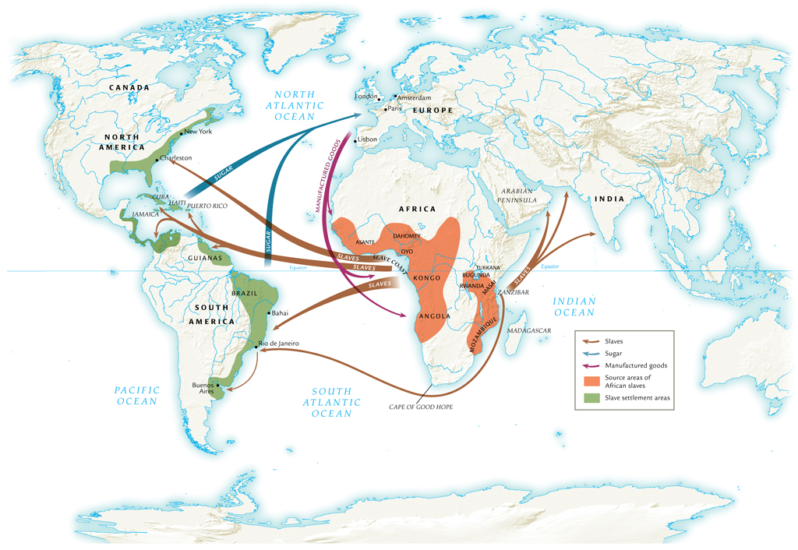
The Atlantic Slave Trade, 1500-1800

Slide 12
The Middle Passage (Africa to Americas)
African slaves captured by raiding parties, force-marched to holding pens at coast
Middle passage under horrific conditions
  4-6 weeks
  Mortality initially high, often over 50%, eventually declined to 5%
Total slave traffic, fifteenth to eighteenth century: 12 million
Approximately 4 million die before arrival

Slide 13
The Islamic Slave Trade
Dramatic expansion of slave trade with Arab traders
New slaves acquired by raiding villages, selling on Swahili coast
Arab traders depend on African infrastructure to maintain supply
European demand on west coast causes demand to rise again

Slide 14
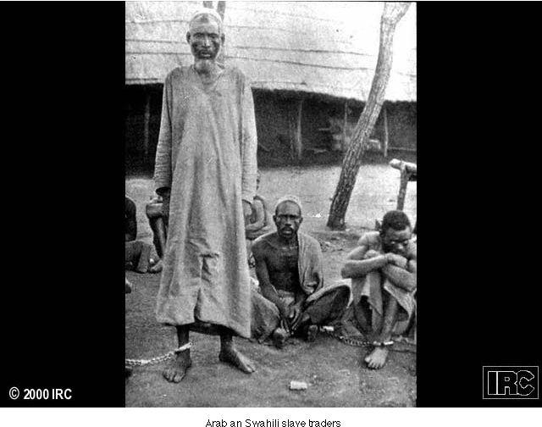
Arab Slave Trader

Slide 15
Impact on African Regions
Rwanda, Bugunda, Masai, Turkana resist slave trade
Benefit from distance from slave ports on western coast
Other societies benefit from slave trade profit
  Asante, Dahomey, Oyo peoples

Slide 16
Social Effects of Slave Trade
Total African population expands due to importation of American crops
Yet millions of captured Africans removed from society, deplete regional populations
Distorted sex ratios result
  Two-thirds of slaves male, 14-35 years of age
  Encouraged polygamy, women acting in traditionally male roles

Slide 17
Political Effects of Slave Trade
Introduction of firearms increases violence of
pre-existing conflicts
More weapons, more slaves; more slaves, more weapons
Dahomey people create army dedicated to slave trade

Slide 18
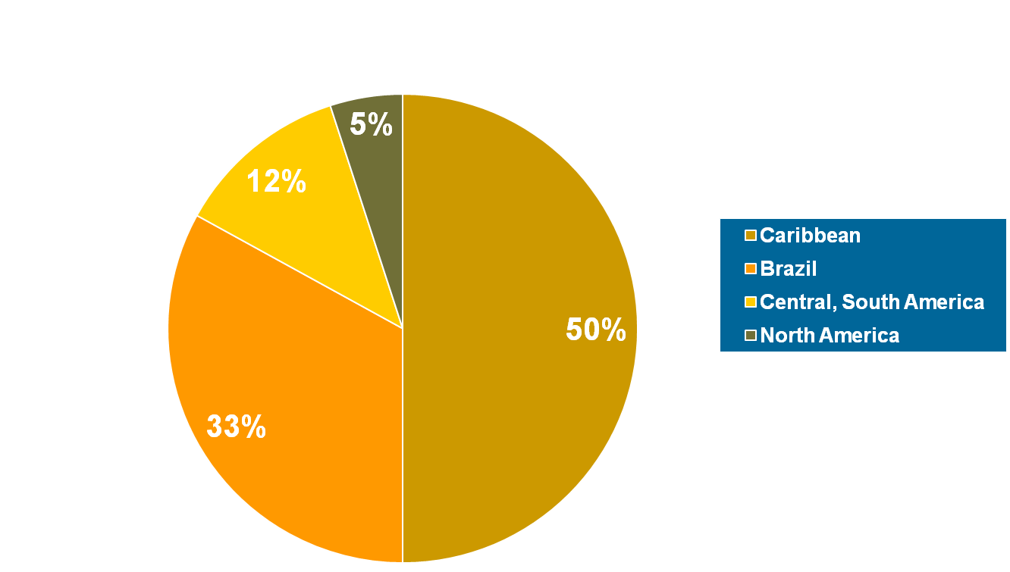
Destinations of African Slaves

Slide 19
Decline and fall of Kongo
Internal strife – power of the king undermined by Portuguese slaving and Christianity
Increased taxes to raise revenue to pay for luxury goods alienated the peasants - revolt
Attempts to rein in Portuguese activities led to their backing his opponents
Invaded by the Jaga in 1658
Alvaro 1 restored in 1674 - puppet

Slide 20
Angola
Founded by coalition of small Ndongo communities.
Located south of the Kongo kingdom and one of their rivals
Ngola was title of the ruler of this centralized kingdom

Slide 21
Portuguese and Angola
Portuguese established port of Luanda in 1575 as a slaving station
Bought slaves from the Ngola and supplied him with firearms
Carried out slave raids on neighboring states
Portuguese also motivated by rumors of abundant silver and gold
Failed to conquer the interior – defeat by the Mbundu and tropical diseases

Slide 22
Nzinga Nkuwa
Also known as Anna Njinga she was the sister of the Ngola and succeeded to the thrown 1623
Entered into alliances with various groups including the Dutch in 1648 Massangano
Conflict between Njinga and Portuguese lasted until 1680s
Lasting legacies –Luso-African community

Slide 23
Impact of the Slave Trade
Western Central Africa part of Slave Coast
Depopulation
Destabilization and Disruption of life
Christianity and its legacy

Slide 24
Other Kingdoms
Lunda Kingdom – ruled by Mwatayamvo
Reached its height in the 17th century
Trade and adoption of new crops maize and cassava
B. Kazembe’s Kingdom – Broke away from Lunda kingdom
C. Buganda – Kabaka is title of the ruler
Agriculture major factor in growth

Slide 25
The Abolition of Slavery
Olaudah Equiano (1745-1797), former slave author’s best-selling autobiography
  Eloquent attacks on institution of slavery
Economic costs of slavery increase
  Military expenses to prevent rebellions
  Eighteenth century: price of sugar falls, price of slaves rises
  Wage labor becomes more efficient
    Wage-earners can spend income on manufactured goods

Slide 26
End of the Slave Trade
Denmark abolishes slave trade in 1803, followed by Great Britain (1807), United States (1808), France (1814), Netherlands (1817), Spain (1845)
Possession of slaves remains legal
Clandestine trade continues to 1867
Emancipation of slaves begins with British colonies (1833), then French (1848), U.S. (1865), Brazil (1888)
Saudi Arabia and Angola continue to the 1960s

